Slide 1
Molecular Dynamics: Force Field Development
Will Smith
Clark Group Meeting
4-March-2021

Slide 2
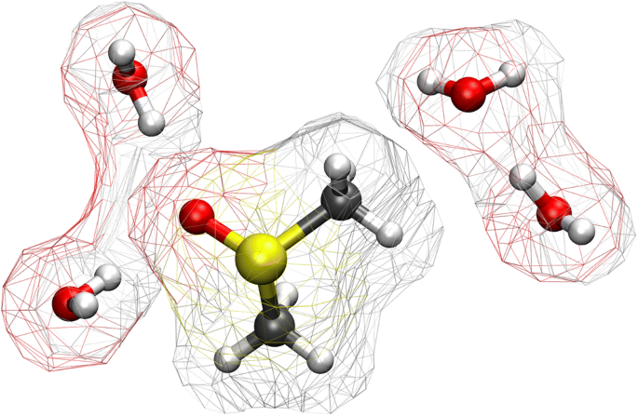
Outline
Introduction to Statistical Mechanic Simulations
Key parameters in a force field
Parameter Optimization
Force Field Coupling – Case Studies

Slide 3
Statistical Mechanical Simulations
All physical transformation evolve along an energy landscape
Each configuration of atoms/molecules has a calculable energy
Changes in the arrangement of atoms leads to a change in the free energy
Equilibrium Ensemble
Represent all possible configurations
thermally populated in a minima
on that surface

Slide 4
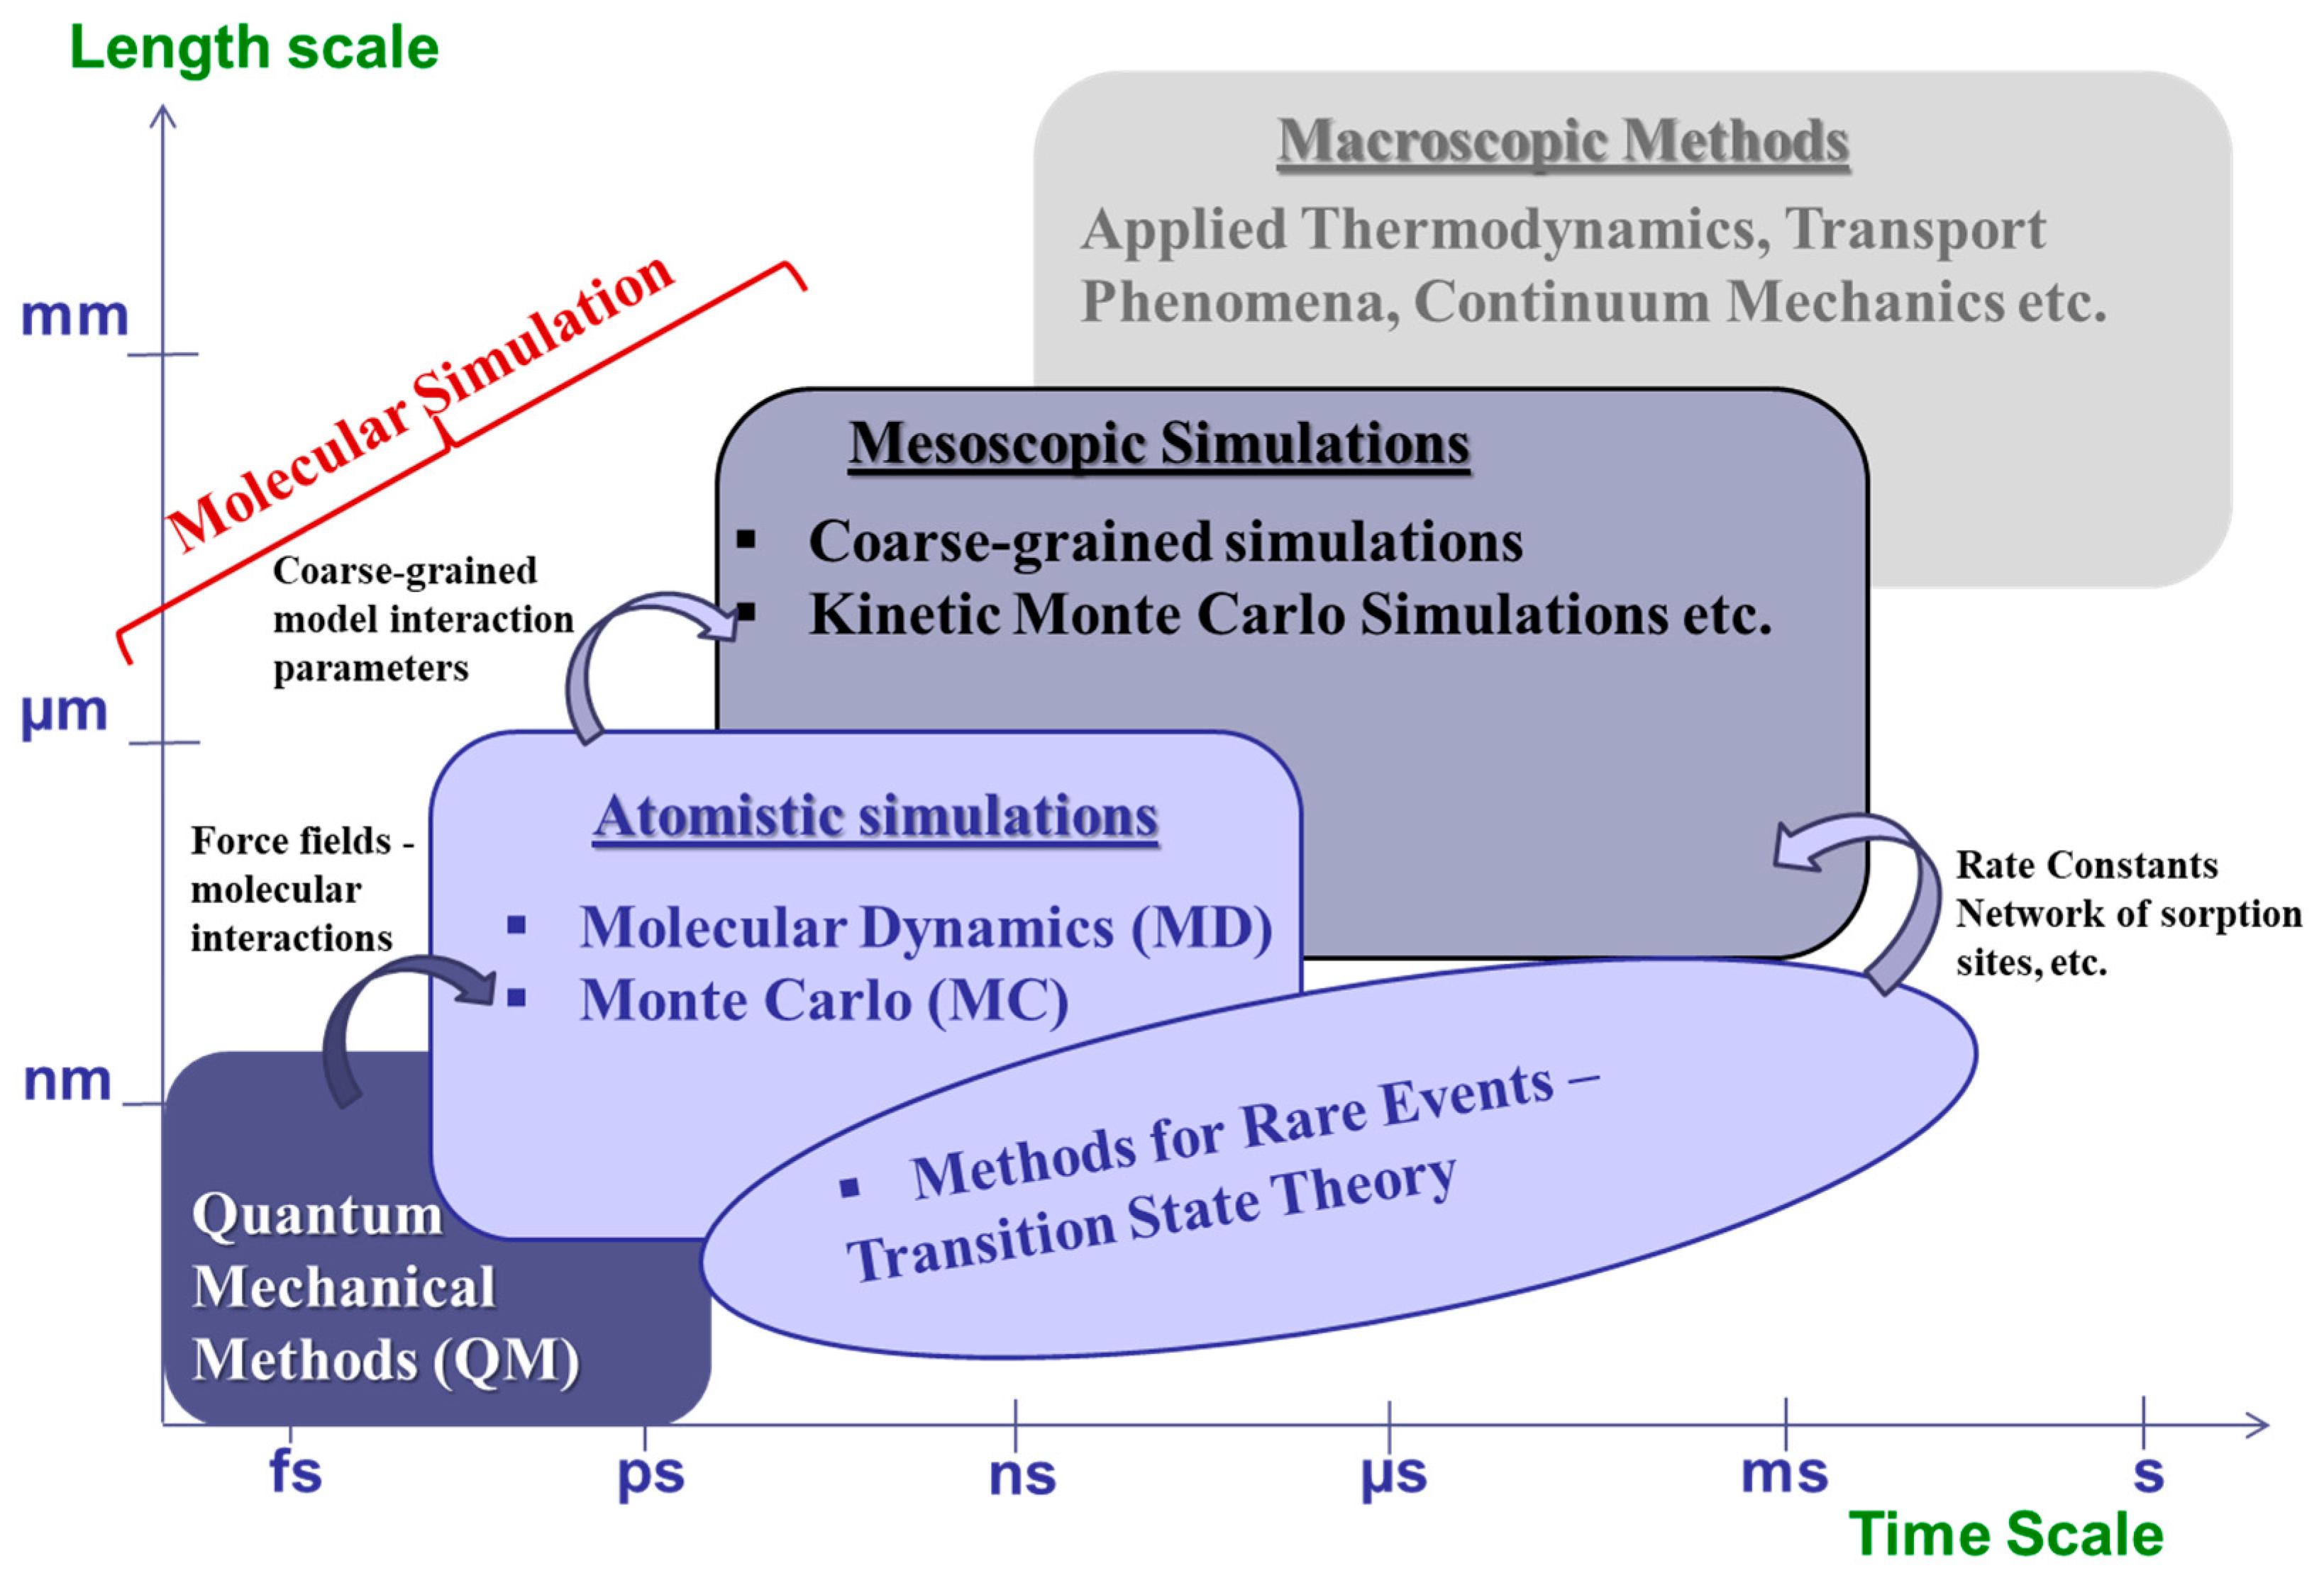
Generate the Equilibrium Ensemble
Primary method our group uses is molecular dynamics
Ab initio and Classical
Ab initio MD uses potentials and basis sets to represent atomic interactions
Classical MD uses force fields to represent those same interactions

Slide 5
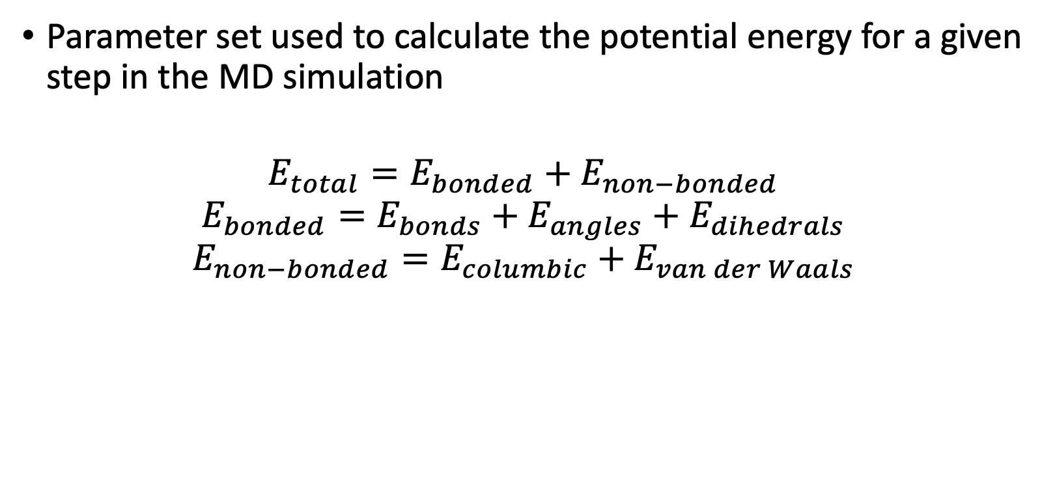
What is a force field?
Parameter set used to calculate the potential energy for a given step in the MD simulation
$$E_{total}=E_{bonded}+E_{non−bonded}$$
$$E_{bonded}=E_{bonds}+E_{angles}+E_{dihedrals}$$
$$E_{non−bonded}=E_{columbic}+E_{van der Waals}$$

Slide 6
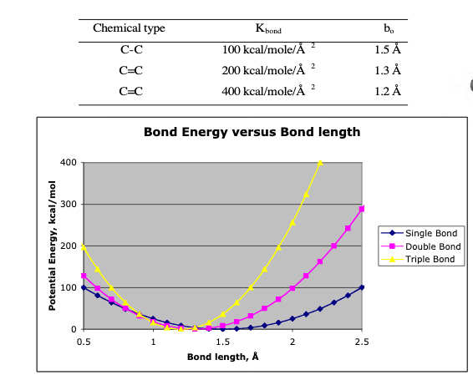
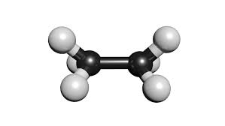
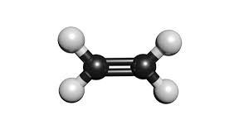
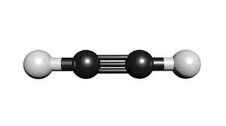
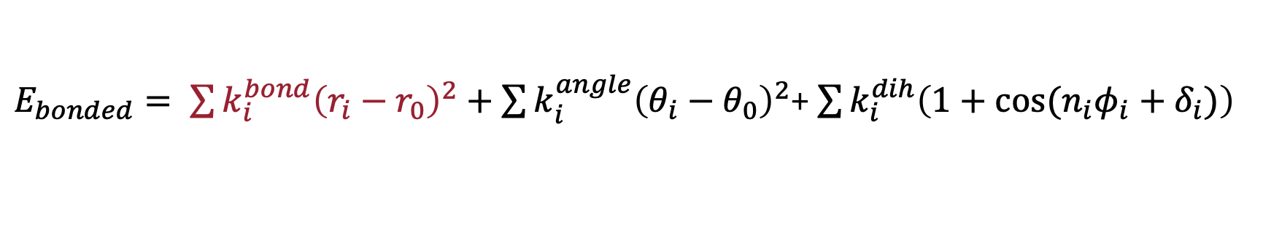
$E_{bonded}= \sum{k_{i}^{bond}{\left(r_{i}−r_{0}\right)}^{2}}+\sum{k_{i}^{angle}{\left(θ_{i}−θ_{0}\right)}^{2}}$+ $\sum{k_{i}^{dih}\left(1+\cos{{(n}_{i}φ_{i}+δ_{i})}\right)}$

Slide 7
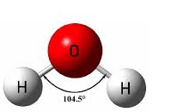
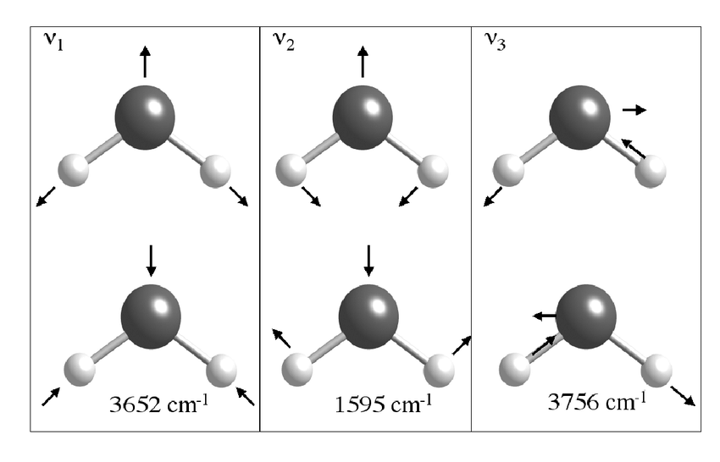
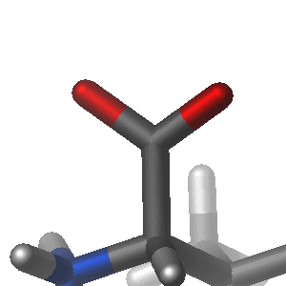
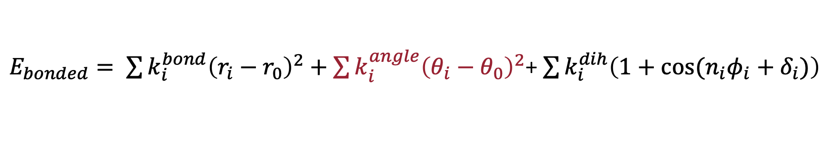
$E_{bonded}= \sum{k_{i}^{bond}{\left(r_{i}−r_{0}\right)}^{2}}+\sum{k_{i}^{angle}{\left(θ_{i}−θ_{0}\right)}^{2}}$+ $\sum{k_{i}^{dih}\left(1+\cos{(n_{i}φ_{i}+δ_{i})}\right)}$
Same harmonic potential form seen in the bond potential however k is often a lower value in the angle potential

Slide 8
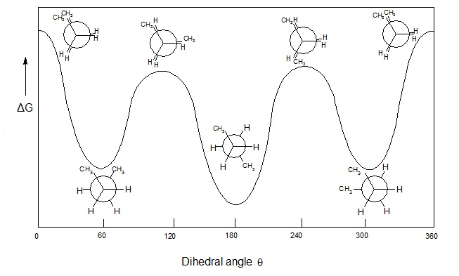
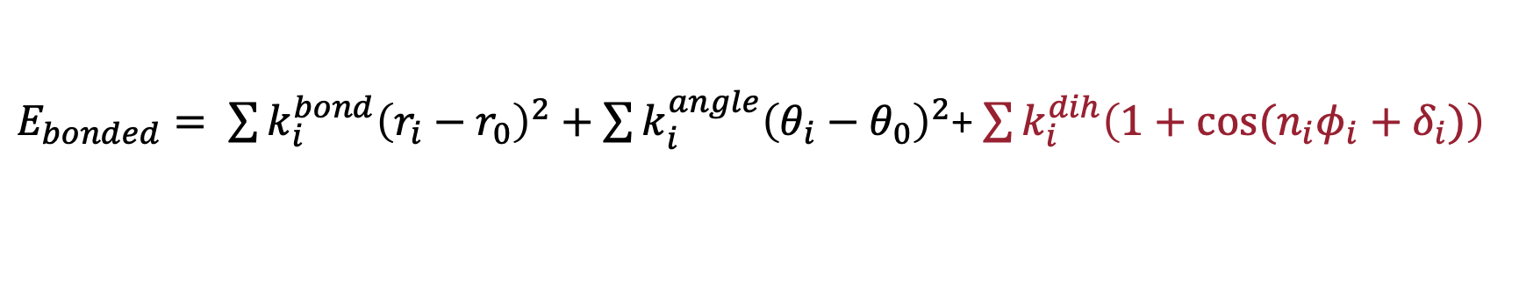
$E_{bonded}= \sum{k_{i}^{bond}{\left(r_{i}−r_{0}\right)}^{2}}+\sum{k_{i}^{angle}{\left(θ_{i}−θ_{0}\right)}^{2}}$+ $\sum{k_{i}^{dih}\left(1+\cos{{(n}_{i}φ_{i}+δ_{i}})\right)}$

Slide 9
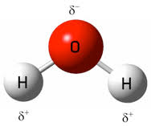
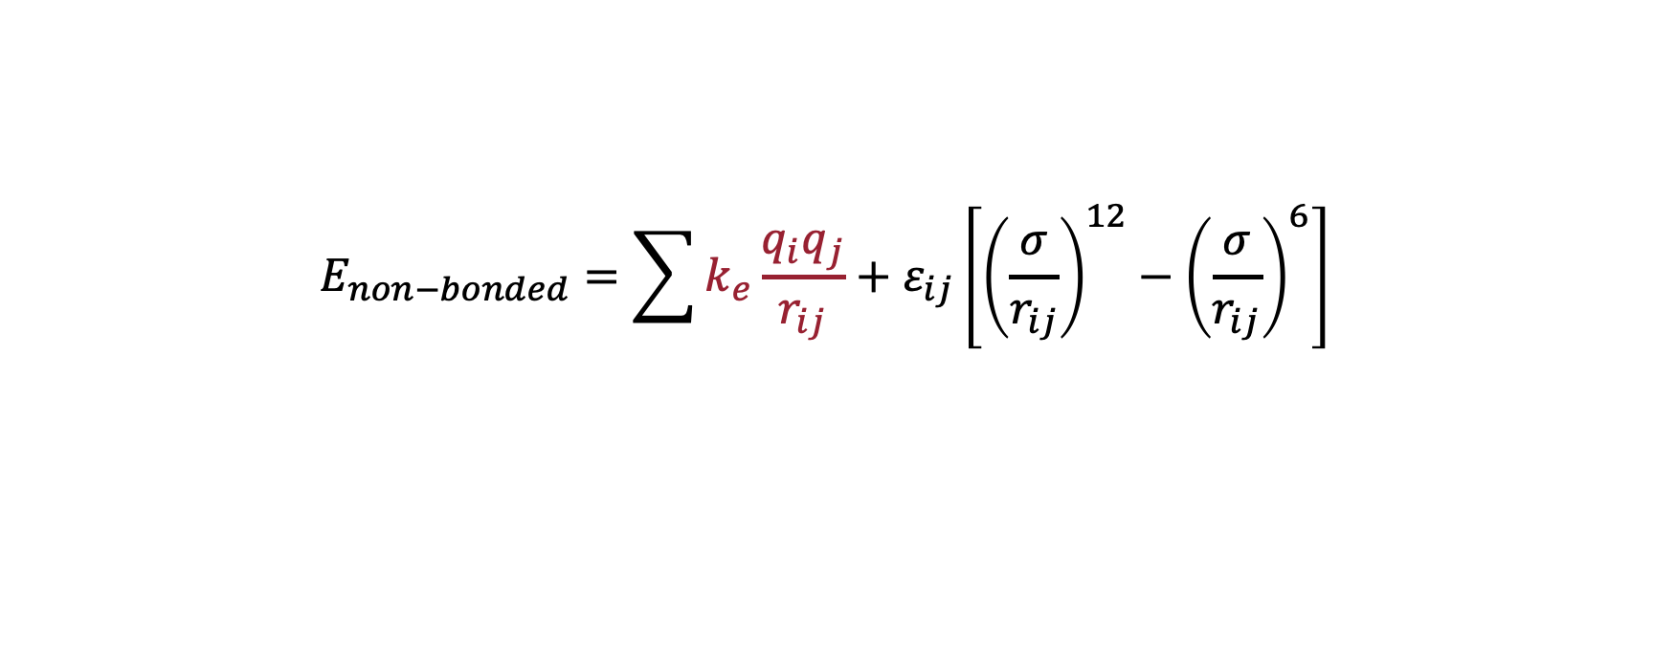
$$E_{non−bonded}=\sum{k_{e}\frac{q_{i}q_{j}}{r_{ij}}+ε_{ij}\left[{\left(\frac{σ}{r_{ij}}\right)}^{12}−{\left(\frac{σ}{r_{ij}}\right)}^{6}\right]}$$
Columbic Potential used to describe electrostatic interactions

Slide 10
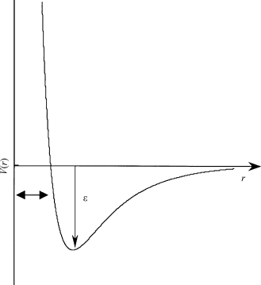
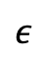
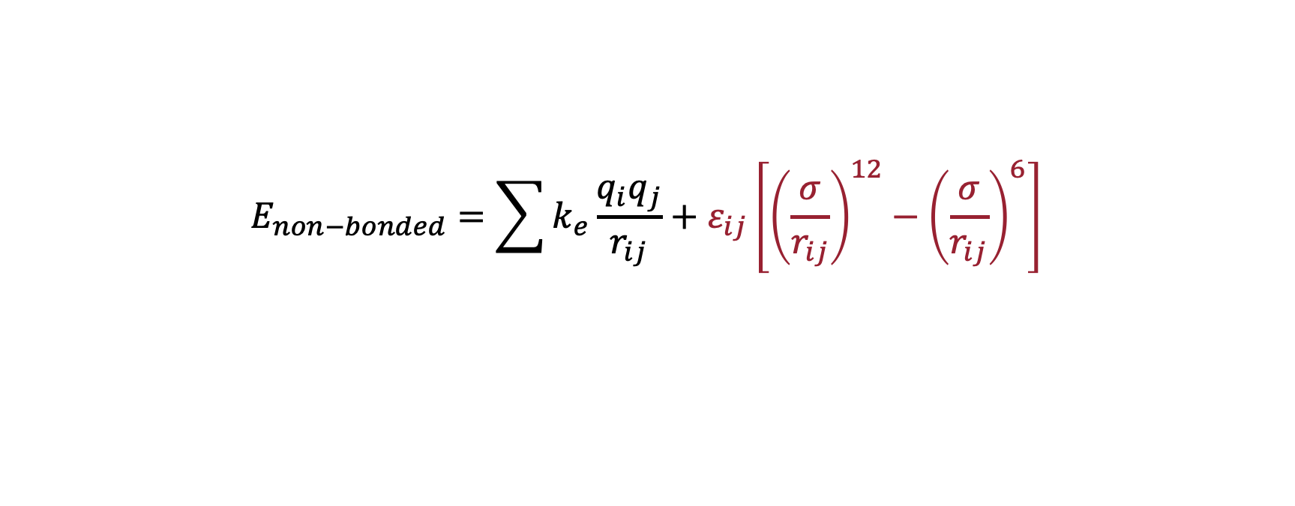

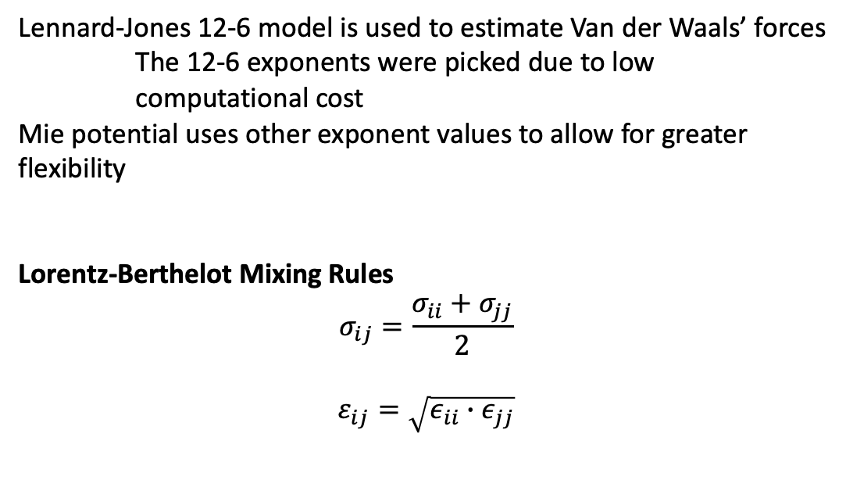
$$E_{non−bonded}=\sum{k_{e}\frac{q_{i}q_{j}}{r_{ij}}+ε_{ij}\left[{\left(\frac{σ}{r_{ij}}\right)}^{12}−{\left(\frac{σ}{r_{ij}}\right)}^{6}\right]}$$
Repulsive
Attractive
Lennard-Jones 12-6 model is used to estimate Van der Waals’ forces
The 12-6 exponents were picked due to low computational cost
Mie potential uses other exponent values to allow for greater flexibility
Lorentz-Berthelot Mixing Rules
$$σ_{ij}=\frac{σ_{ii}+σ_{jj}}{2}$$
$$ε_{ij}=\sqrt{ε_{ii}∙ε_{jj}}$$
$$σ$$
$$ε$$

Slide 11
Parameter Optimization
Experimental Data
Structural fitting to XRD/neutron scattering
NMR
Quantum Mechanical Results
Free energy calculations
Mechanistic studies
Local Environment

Slide 12
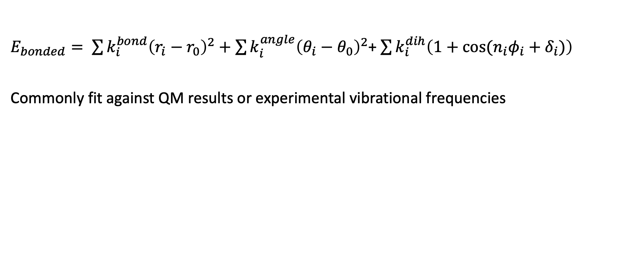
Optimization of bonding terms
$E_{bonded}= \sum{k_{i}^{bond}{\left(r_{i}−r_{0}\right)}^{2}}+\sum{k_{i}^{angle}{\left(θ_{i}−θ_{0}\right)}^{2}}$+ $\sum{k_{i}^{dih}\left(1+\cos{{(n}_{i}φ_{i}+δ_{i})}\right)}$
Commonly fit against QM results or experimental vibrational frequencies

Slide 13
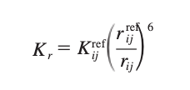
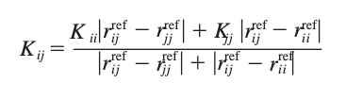

Bond Potential Energy: $\sum{k_{i}^{bond}{\left(r_{i}−r_{0}\right)}^{2}}$
Several Resources to derive equilibrium bond distance (r₀)
Mean values from X-ray and Neutron Diffraction
High level ab initio calculations
The force constant can be determined using empirical methods (Badger’s formula)
K_{r}=calculated force constant
r_{ij}=actual bond length
K_{ij}=empirical parameter

Slide 14
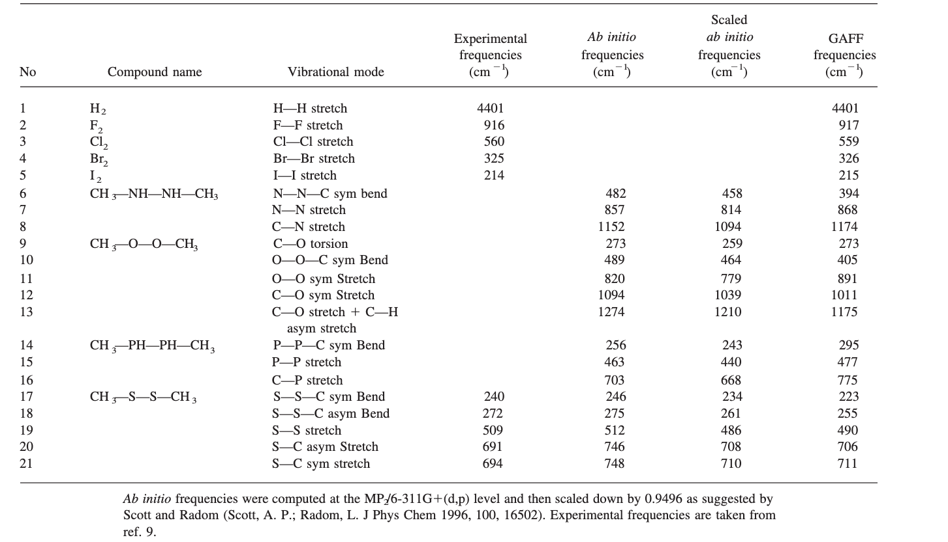
Bond Potential Energy: $\sum{k_{i}^{bond}{\left(r_{i}−r_{0}\right)}^{2}}$
The K_{ij} parameter can be fit
using prior force field results or
derived using vibrational
frequency analysis.
Many different methods
Ease of use
Accuracy
Dependence on non-bonded
parameters
*Same methods are applied to Angle
and Torsion terms

Slide 15
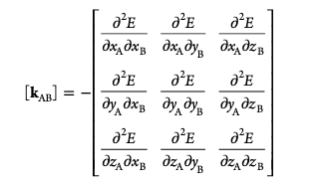
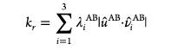
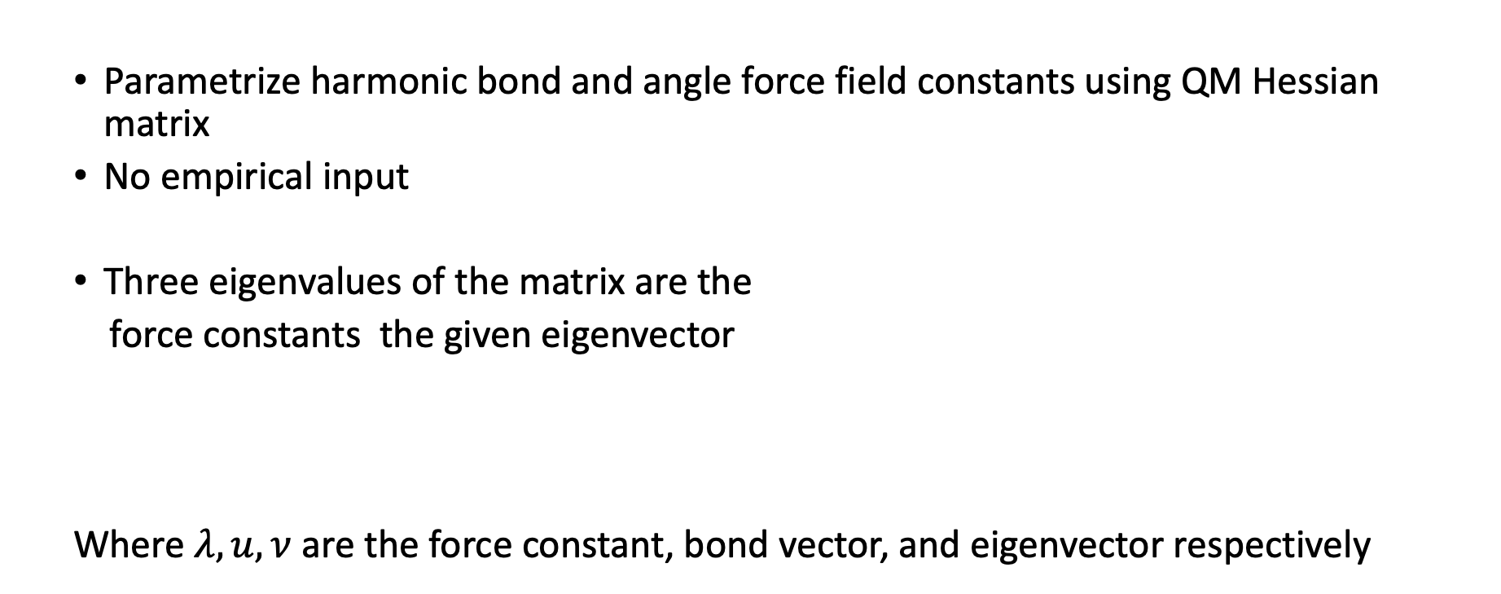
Bond Potential Energy: $\sum{k_{i}^{bond}{\left(r_{i}−r_{0}\right)}^{2}}$
Parametrize harmonic bond and angle force field constants using QM Hessian matrix
No empirical input
Three eigenvalues of the matrix are the
force constants the given eigenvector
Where $λ, u, ν$ are the force constant, bond vector, and eigenvector respectively
Seminario Method

Slide 16
Bond Potential Energy: $\sum{k_{i}^{bond}{\left(r_{i}−r_{0}\right)}^{2}}$
Parametrize harmonic bond and angle force field constants using QM Hessian matrix
No empirical input
Three eigenvalues of the matrix are the
force constants the given eigenvector
Where $λ, u, ν$ are the force constant, bond vector, and eigenvector respectively
Seminario Method

Slide 17
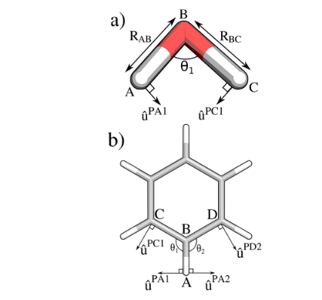
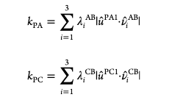
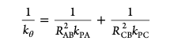
Seminario Method
Calculating angle force constant
Fails at larger molecules

Slide 18
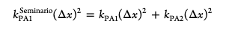
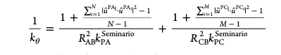
Seminario Method
Fails at larger molecules
Double counts changes in energy
Results in a force field that is too stiff
Rescale the original value by accounting for the geometry of the molecule
N and M are neighboring angles sharing central atom (if N/M=1, use original Seminario Method)

Slide 19
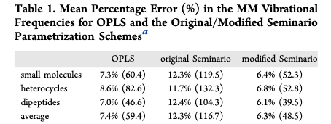
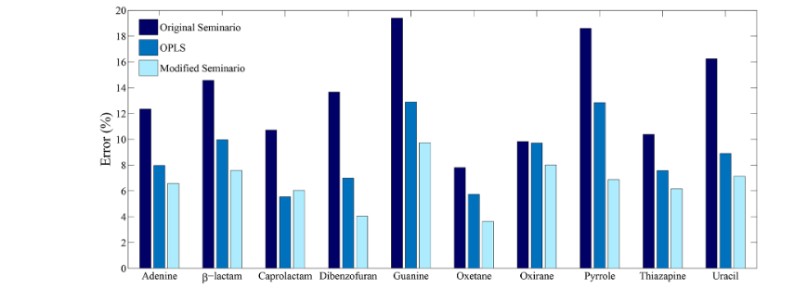
Modified Seminario Method
Average error in vibrational frequencies when compared to QM
Most notable differences in
Heterocyclic compounds

Slide 20
Optimization of Non-bonding Terms
Electrostatic Potential Methods
Mulliken population analysis
ECC (electronic continuum correction)
ECCR (electronic continuum correction with rescaling)
ESP (electrostatic potential)
RESP (restrained electrostatic potential)

Slide 21
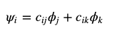
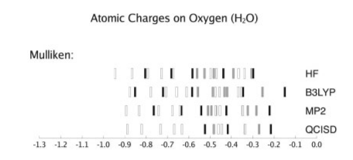
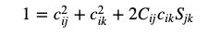
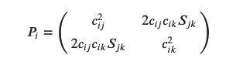
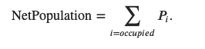
Mulliken Population Analysis
Charges are easily calculated
Highly Dependent on wavefunction and basis set used
White, Grey, and Black are used to represent Pople, cc-, and Aug cc-basis sets respectively

Slide 22
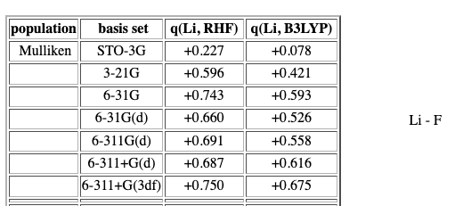
Mulliken Population Analysis
Charges are easily calculated
Highly Dependent on wavefunction and basis set used

Slide 23
Mulliken Population Analysis
Charges are easily calculated
Often over estimation of the bond covalence

Slide 24
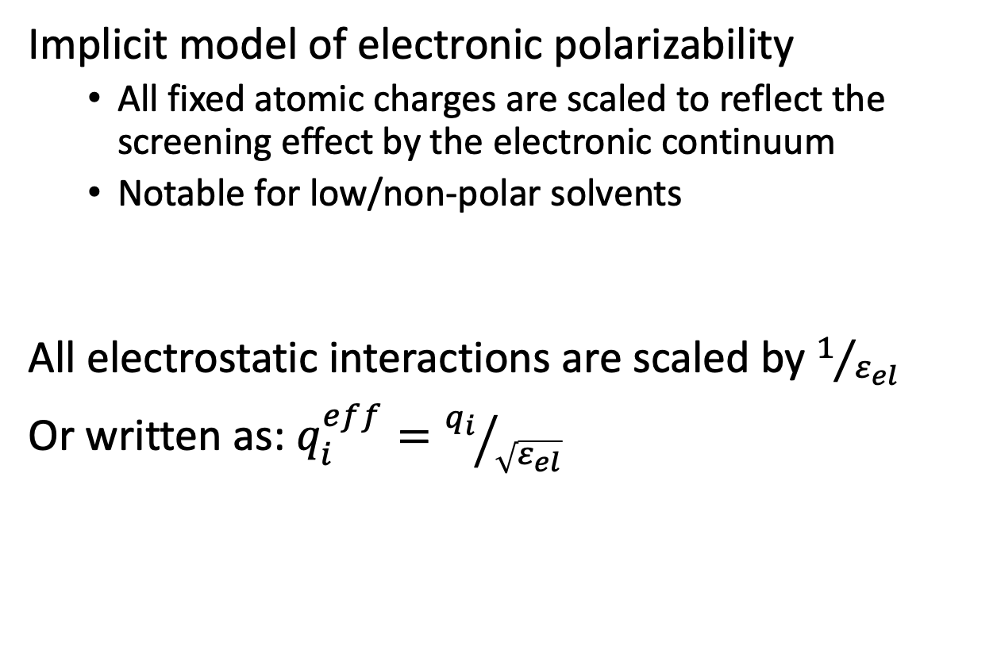
Electronic Continuum Correction
Implicit model of electronic polarizability
All fixed atomic charges are scaled to reflect the screening effect by the electronic continuum
Notable for low/non-polar solvents
All electrostatic interactions are scaled by $1/{ε_{el}}$
Or written as: $q_{i}^{eff}={q_{i}}/{\sqrt{ε_{el}}}$

Slide 25
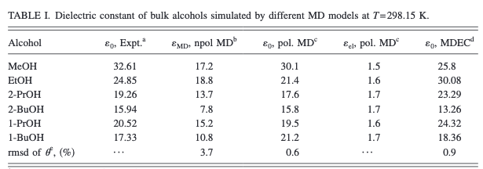
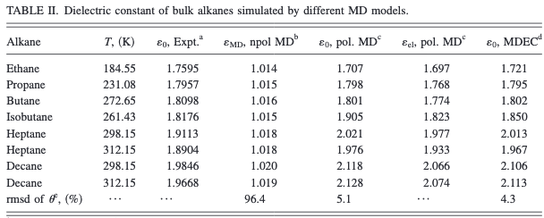
Electronic Continuum Correction
Small improvements on the polar solvents but significant improvement on the non-polar alkanes

Slide 26
Electronic Continuum Correction
Small improvements on the polar solvents but significant improvement on the non-polar alkanes
*The density of multivalent ionic solutions did not match neutron scattering experiments

Slide 27
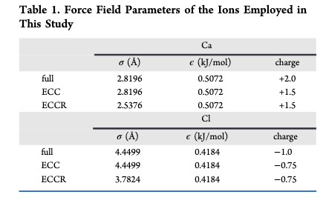
Electronic Continuum Correction with Rescaling
Rescale the remaining non-bonding terms (Lennard Jones Potential)
$$σ$$
$$ε$$
*The ionic charge was changed but
not the ionic radius in ECRR

Slide 28
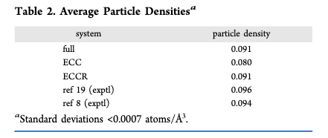
ECCR
Decreased Cl and Ca radii by 10% and 15%, respectively, to better match neutron scattering data
*The ionic charge was changed but
not the ionic radius in ECRR

Slide 29
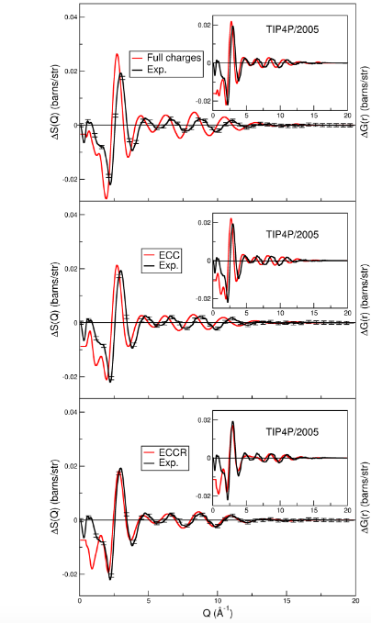
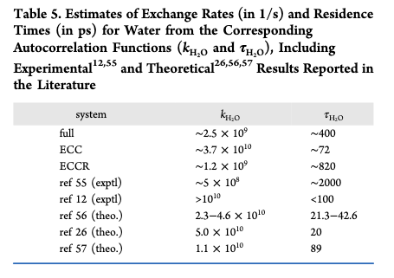
ECCR
Charge scaling increases dynamics while rescaling radii decreases

Slide 30
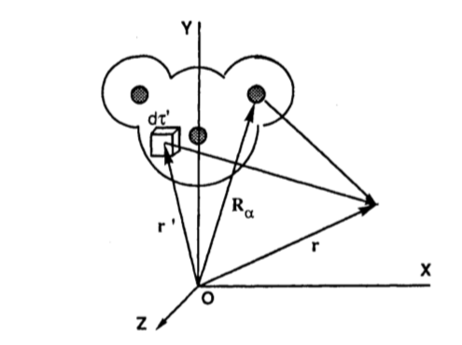
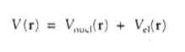
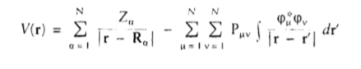
Electrostatic Potential (ESP)
Calculate molecular electrostatic potential to determine partial atomic charges
Determine electrostatic potential in a grid around molecule using +1e⁻ point

Slide 31


ESP
Generates electric potential contour maps
q_{j} = partial atomic charge positioned at R_{j}
V_{el} = calculated electrostatic potential at grid point r_{i}

Slide 32

ESP
Partial charges are less dependent on underlying theory used
Comparison of charges of oxygen of H₂O between methods

Slide 33

ESP
Short fallings of ESP:
Molecular electrostatic potential doesn’t represent inner atoms for large molecules
Molecules with multiple confirmations may require averaging

Slide 34

ESP
Molecular electrostatic potential doesn’t represent inner atoms for large molecules
ESP points are always beyond VDW surface
Charge of Oxygen was insignificant to the overall fitting (lone pairs were independent centers)
Relaxation of their partial charge model led to overlap of nuclei and electrons
Restraining O-e⁻ distance to 0.6 Å led to a 1% poorer fit

Slide 35
ESP
Molecules with multiple confirmations may require averaging
must determine all possible confirmations
Boltzmann weighing according to relative conformer energy
Often conformer energies are calculated in gas phase – not optimizing the FF for solvent, the ideal context
Increased computational cost with more rotating bonds

Slide 36
ESP
Short fallings of ESP:
Molecular electrostatic potential doesn’t represent inner atoms for large molecules
Molecules with multiple confirmations may require averaging
Not suitable for biomolecules

Slide 37
Restrained Electrostatic Potential
Introduce a “penalty function” in the optimization in the form of restraints to partial atomic charges to a target charge
Used nonharmonic restraint for a target charge of 0

Slide 38

Ideal Target Charge
The Mulliken target provides inconsistent results

Slide 39


Ideal Target Charge
Setting the target to 0 provided closer results to QM ESP calculations
Harmonic potential underrepresented polarity of tested molecules:
-OH on methanol

Slide 40


Ideal Target Charge

Slide 41
Optimization of Non-bonding Terms
Lennard-Jones Potential Methods
General Utility Lattice Program – solid state structures
Fitting to liquid densities/heat of vaporization for liquid systems
Vapor-liquid coexistence curves

Slide 42
Force Matching Method
Obtaining realistic force field parameters using large data developed using ab initio methods
Removes transferability concern of traditional FF development
Minimization occurs across >100 parameters
First applied to Al metal

Slide 43

Force Matching Method
First Application on Al
40 Parameters
Systems ranging from bulk material, liquid at 2650 K, and (100) slab

Slide 44

Force Matching Method
User-friendly software has been developed to promote the implementation of Force Matching Method

Slide 45

Force Field Coupling – Literature Example
Traditionally force fields are not transferable
Each have been uniquely parameterized for their system
Increased area of interest in the organic-inorganic interface field

Slide 46

Modeling of Alkylated Quartz Surfaces
Organic is chemisorbed onto the surface (O-C bond) not described by either force field
Removal of H from surface violates system neutrality

Slide 47

Modeling of Alkylated Quartz Surfaces
Optimize the structure and calculate partial charges using geometry optimization/single point energy calculation
Determined O = 90% of initial charge
Remaining H-C atoms on organic kept partial charges seen in DREIDING FF
Bond distances matched prior FF lengths
Lorentz−Berthelot mixing used for non-bonding terms

Slide 48


Modeling of Alkylated Quartz Surfaces
Compared wettability between different pentyl surface group concentration 1.45 vs 2.89 groups/nm²
Small addition of hydrophilic molecules at the interface lead to a drastic change in the wettability of the surface (contact angle 118 -> 180)

Slide 49
Questions?

